Slide 1

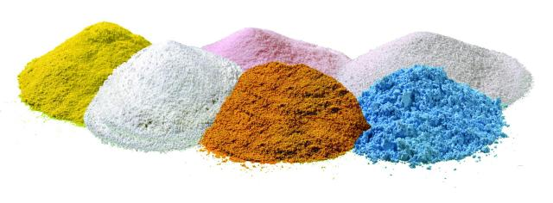
16. Boiling Salt Solutions
The boiling temperature of aqueous salt solution is variable and may be higher than ${100}^{o}C$. Formulate a problem requiring theoretical and experimental studies with chemical compositions of your choice.
Investigate the boiling point of aqueous salt solution for different salt concentrations and different group salts.
Reporter: Nikoloz Burduli

Slide 2
Plan
Explanation of the phenomenon;
What is the boiling point;
Why does the boiling temperature of an aqueous solution of salt increase;
Theoretical model;
The formula for the change of boiling temperature;
Experiments;
Experimental Setup;
Different types of salts;
Different concentrations of salts;
Comparison of theoretical and experimental results;
Theoretical and experimental graphs;
Conclusion;
Relevant parameters;
Analysis of results;

Slide 3
Explanation of the phenomenon

Slide 4

Notes:
As we know, there are hydrogen bonds in water, which breaks as the water temperature rises. At the temperature when hydrogen bonds are completely broken, air bubbles are formed and begin to move. The boiling point is that temperature at which the vapor pressure of a liquid equals the atmosphere pressure.

Slide 5
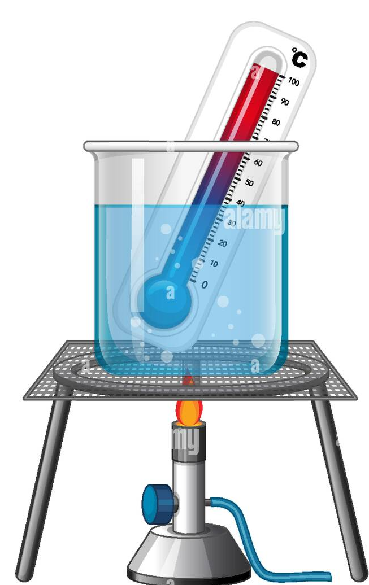

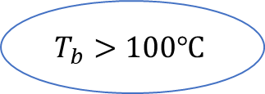
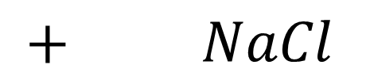
Change in boiling temperature
$$T_{b}>100℃$$
Adding salt to water changes the boiling temperature !
$+ NaCl$
Notes:
Let’s consider our problem on the example of NaCl. If we will take water, add NaCl and boil it, we will notice that it will take higher than 100 degree to boil. So adding salt to water changes the boiling temperature.

Slide 6
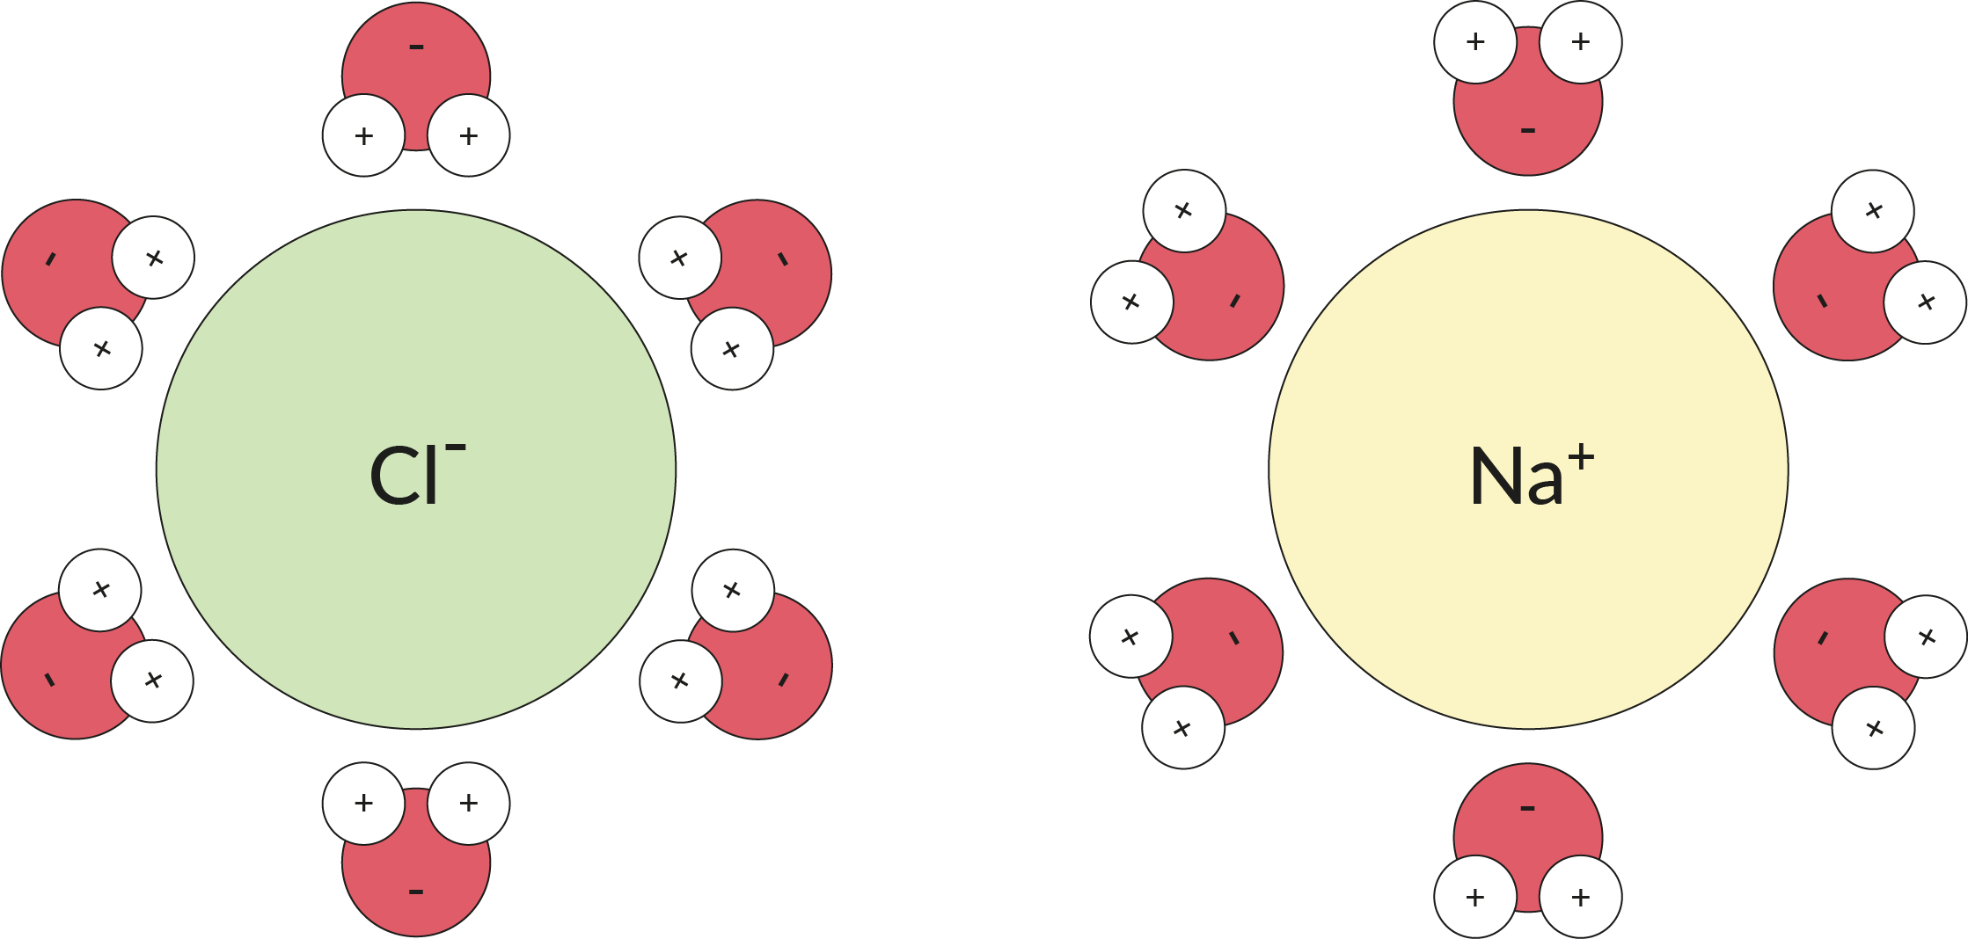
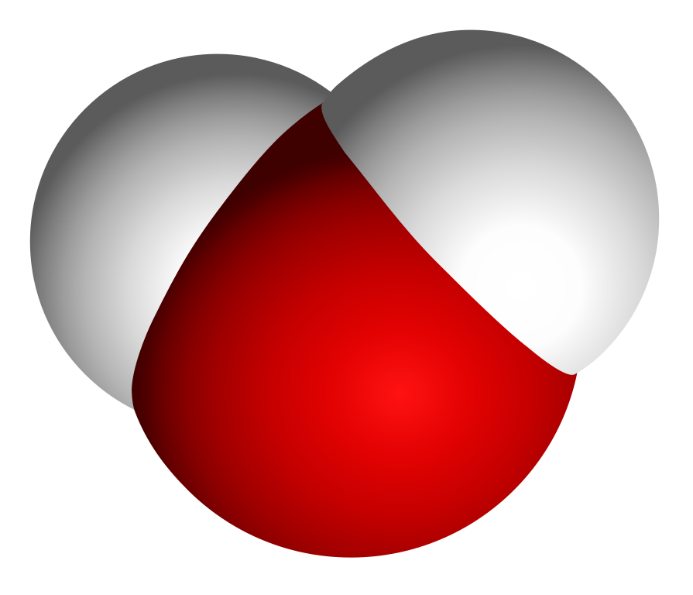
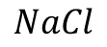
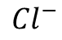
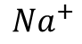
Why does the boiling point change
$$NaCl$$
The Ion-dipole interaction is stronger than the hydrogen bond, so salt water needs a higher temperature to boil!
$${Na}^{+}$$
$${Cl}^{−}$$
Ion-dipole interaction
Notes:
In the example of NaCl, when dissolved in water it dissociates into two ions: positive sodium ion and negative chlorine ions. In the water molecule we have negative OH and positive hydrogen. So sodium binds to OH and chlorine binds to hydrogen as charges of opposite sign. Such connection is called ion-dipole interaction. This interaction is stronger than the hydrogen bond and it needs more energy to break the connection.

Slide 7
Theoretical Model

Slide 8
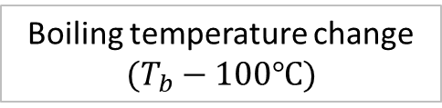



A change in the boiling point of the solution
Molar constant of the solvent
$$K_{b}=0.512[C∗\frac{kg}{mole}]$$
Van’t Hoff factor
$$i= α(n−1)+1$$
$$∆T= K_{b}∗ m ∗ i$$
Degree of dissociation
Boiling temperature change
$$(T_{b}−100℃)$$
The number of ions after dissociation
The molar concentration of the salt
Notes:
As we researched most of salts have degree of dissociation close to one. So in most cases Van't Hoff factor matches the number of dissociated ions. This is because that in salts we have ionic bonds, which are weak and break easily.
Dissociation and solubility are almost the same thing, although a salt needs to dissociate in water, or break up into ions.

Slide 9
Experimental Part

Slide 10
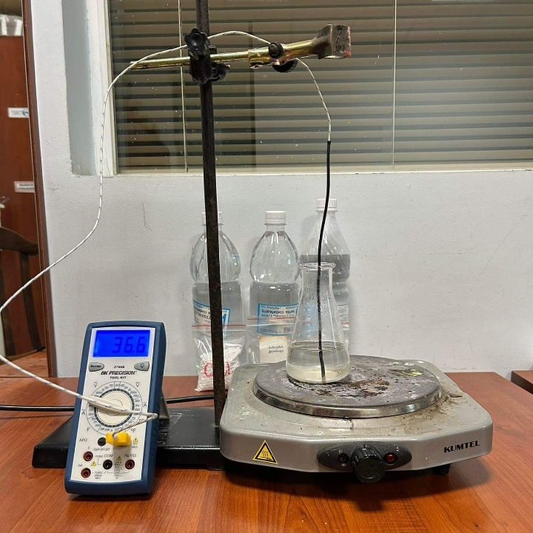
Experimental setup
Distilled water
Thermal couple
Salt solution
Multimeter
Notes:
Sodiom chloride, Potassium nitrate, copper sulfate, potassium chloride.

Slide 11


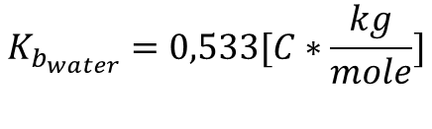
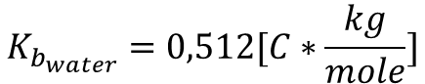
Determination of $K_{b}$constancy
$$K_{b}=\frac{∆T}{m∗i}$$
$$K_{b_{water}}=0,512[C∗\frac{kg}{mole}]$$
Theoretical
Experimental
$$K_{b_{water}}=0,533[C∗\frac{kg}{mole}]$$

Slide 12
The influence of concentration
Different types of salts don’t affect the result if they have the same Van’t Hoff factor.
Notes:
. If we have different types of salts but with the same concentration and the same van't Hoff factor, their boiling points will be the same. So we can say that type of salt does not affect on the result.
The temperature of boiling water does not change anymore, and when the temperature was constant, I considered it to be the boiling temperature

Slide 13
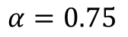
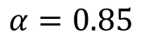
Salts with Van’t Hoff factor 3
$$α=0.85$$
$$α=0.75$$

Slide 14


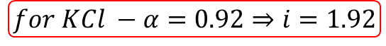

Salt with degree of dissociation 0.2
$$KCl$$
$$MgSO_{4}$$
$α=0.2⇒i=1.2$
$$for KCl −α=0.92⇒i=1.92$$

Slide 15
The final part

Slide 16
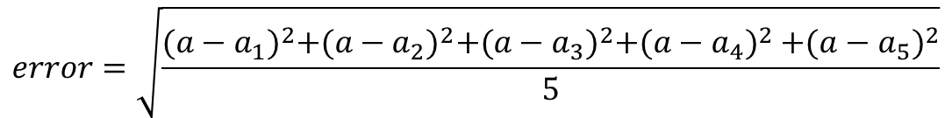
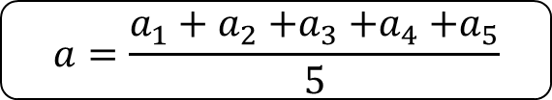
Calculation of experimental error
Experimental results
$$a=\frac{a_{1}+a_{2}{+a}_{3}{+a}_{4}{+a}_{5}}{5}$$
N | Temperature
1 | 103
2 | 102.7
3 | 103.3
4 | 103.1
5 | 102.9
$$error=\sqrt{\frac{{(a−a_{1})}^{2}+{(a−a_{2})}^{2}+{(a−a_{3})}^{2}{+(a−a_{4})}^{2}{+(a−a_{5})}^{2}}{5}}$$
!
Each experiment was conducted five times

Slide 17
Comparison of theoretical and experimental results

Slide 18

Conclusion
Molar concentration;
Molar constant of solvent;
Van’t Hoff factor;
Degree of dissociation
!
Molar concentration
$$∆T= K_{b}∗m∗i$$
Notes:
The degree of dissociation of different salts differs very little from each other and is approximetly equal to one.

Slide 19
Thanks for attention!

Slide 20
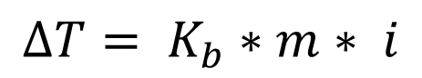
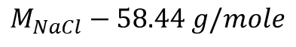
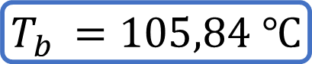
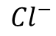
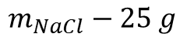
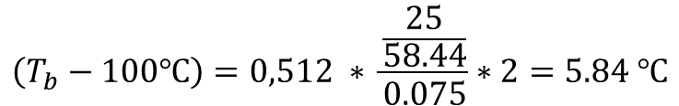
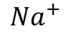
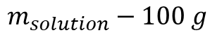
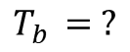
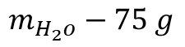
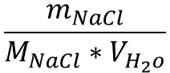
A change in the boiling point of the solution
$$∆T= K_{b}∗m∗ i$$
$$m_{NaCl}−25 g$$
$$m_{H_{2}o}−75 g$$
$$m_{solution}−100 g$$
$$M_{NaCl}−58.44 g/mole$$
$$\frac{m_{NaCl}}{M_{NaCl}∗V_{H_{2}o}}$$
$${Na}^{+}$$
$${Cl}^{−}$$
$$T_{b }= ?$$
$$\left(T_{b}−100℃\right)=0,512 ∗ \frac{\frac{25}{58.44}}{0.075}∗2=5.84 ℃$$
$$T_{b }=105,84 ℃$$

Slide 21

The influence of concentration

Slide 22
The influence of concentration

